Slide 1


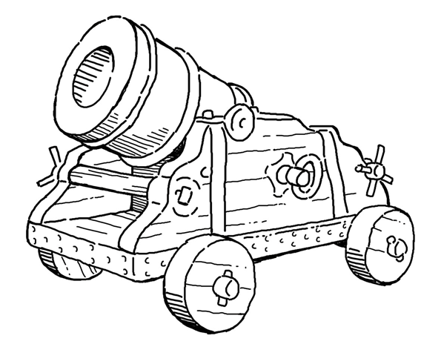


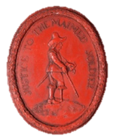
Sieges

Slide 2
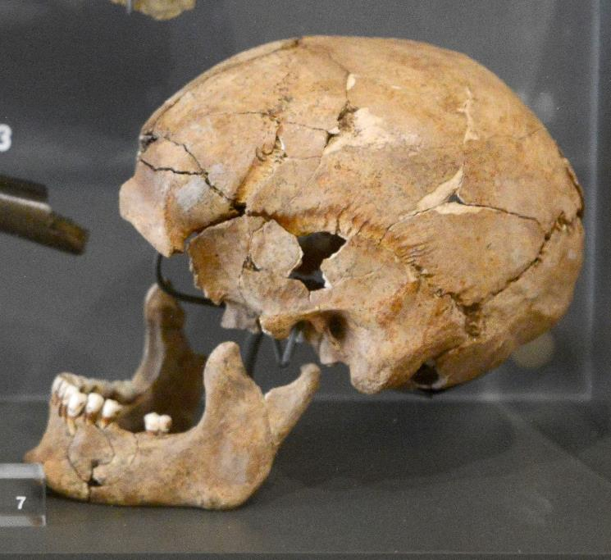


What do you think happened to this person?

Slide 3
Peace in England
This is the skull of a soldier who died from a blow to the head during The Wars of the Roses.
This was a civil war that placed the Tudors on the English throne.
Skull of a soldier killed at the Battle of Stoke Field
On display at Newark Museum, Nottinghamshire

Slide 4
Peace in England
The last battle of The Wars of the Roses was fought in 1487 at Stoke Field in Nottinghamshire.
For almost 200 years after this, most military action had taken place abroad.
Skull of a soldier killed at the Battle of Stoke Field
On display at Newark Museum, Nottinghamshire

Slide 5
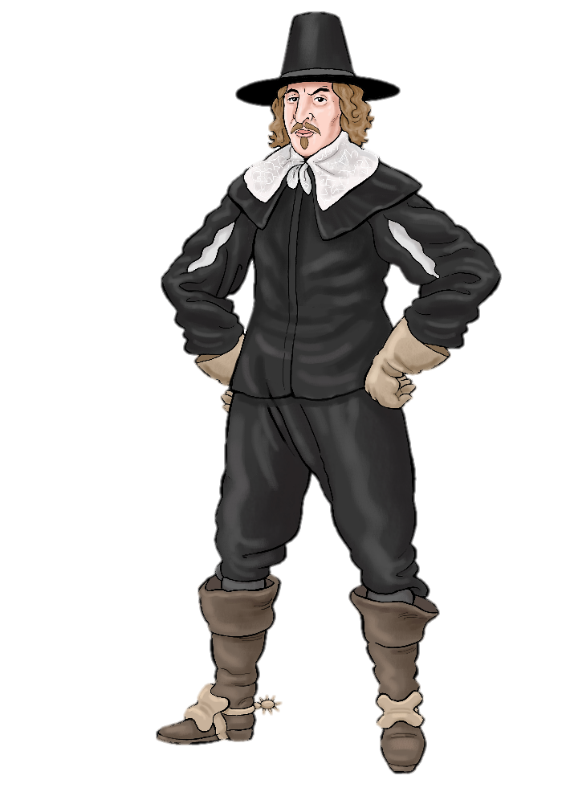
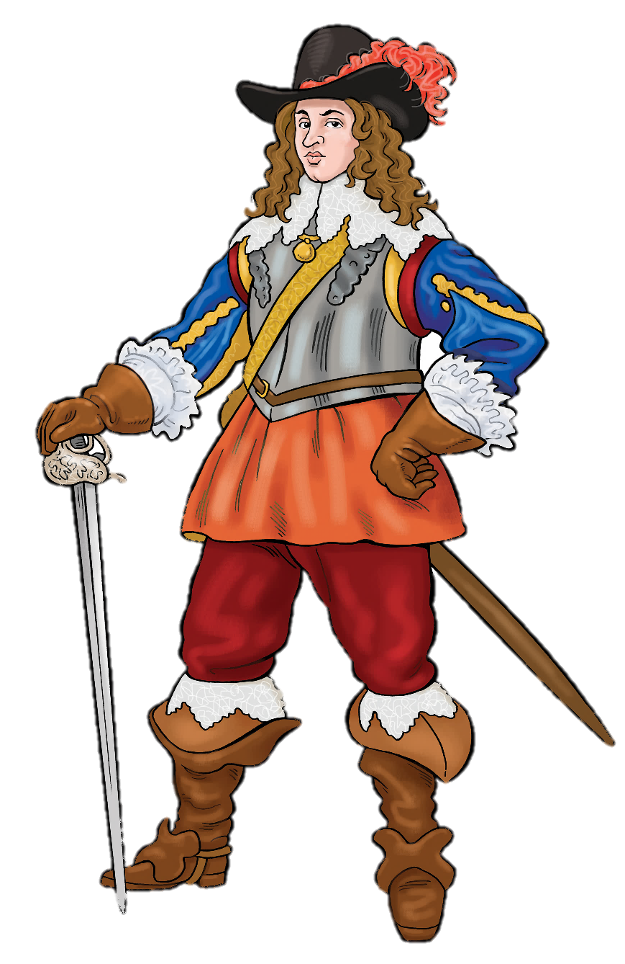
The British Civil Wars
But in 1642 another civil war broke out in England.
This was a war between supporters of King Charles I and supporters of Parliament.

Slide 6
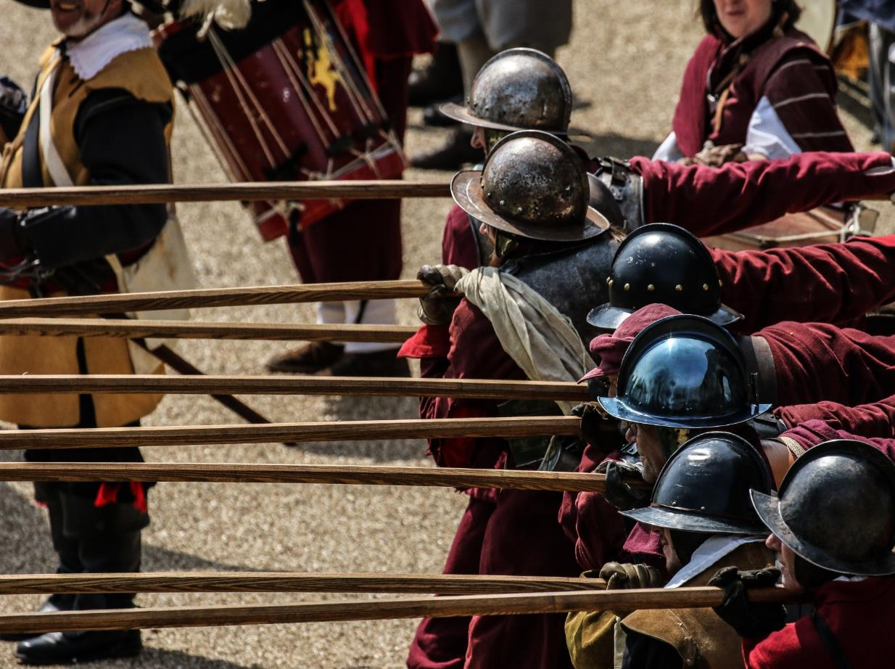
There were huge battles during The British Civil Wars.
.

Slide 7
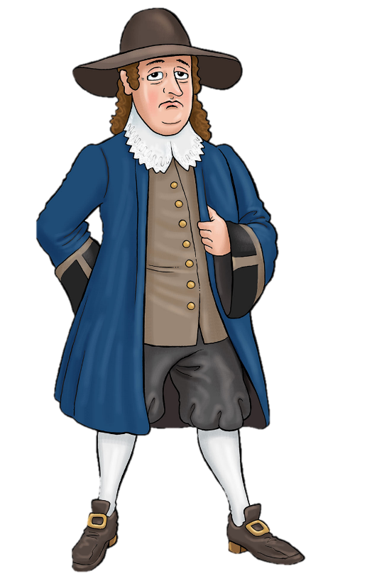
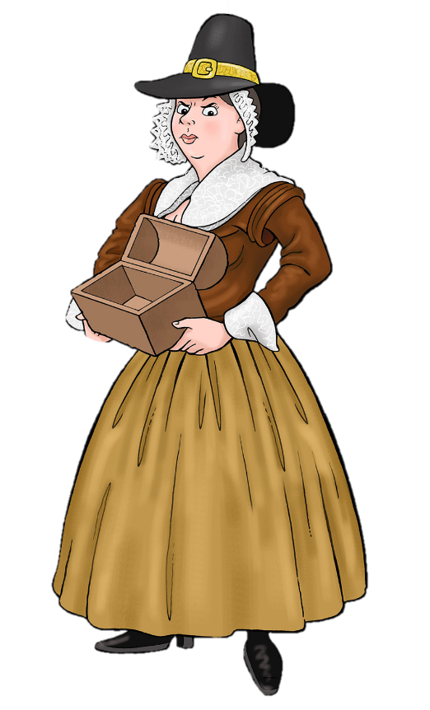
But a civil war is not only fought on battlefields far away from where people live.
It travels to towns and villages all over the country.
It affects ordinary people everywhere.

Slide 8
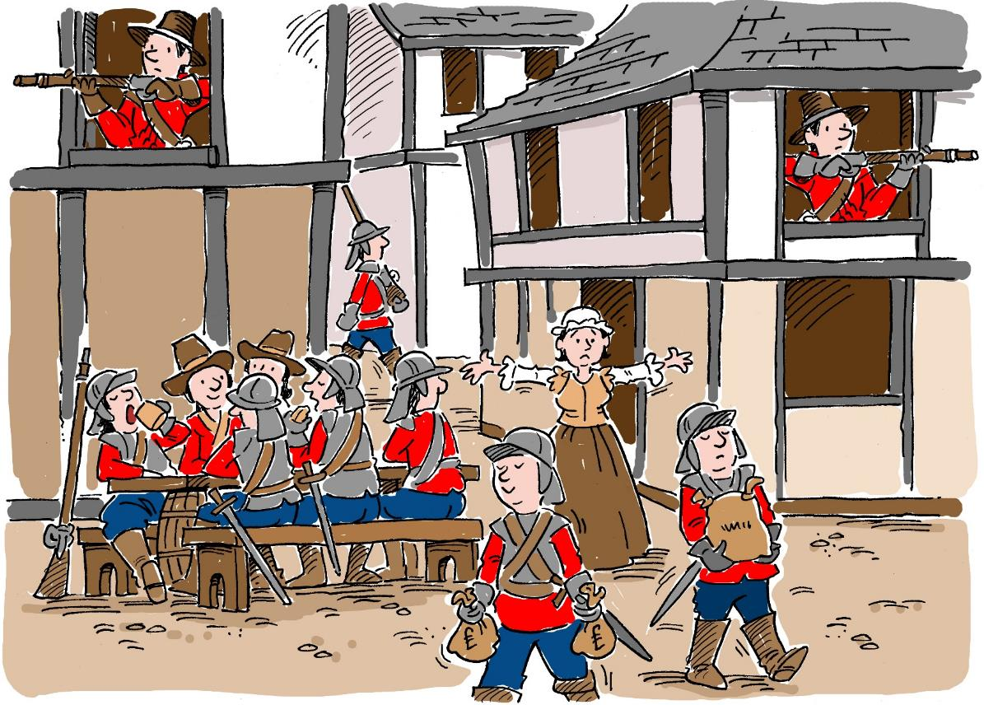
Garrisons (military bases)
In order to win the war, both sides established garrisons in important locations.
This means that they placed an army in a town or a large house to defend it.

Slide 9


The soldiers were billeted in the homes of people living in or around the garrison. This meant they lived with local people.
Local people had to give the soldiers all the things they needed like food, clothes and medical supplies. This made many ordinary people very poor.
Click here to find out more about what ordinary people lost

Slide 10
Civilians
(ordinary people who were not soldiers)
were also affected by
siege warfare

Slide 11
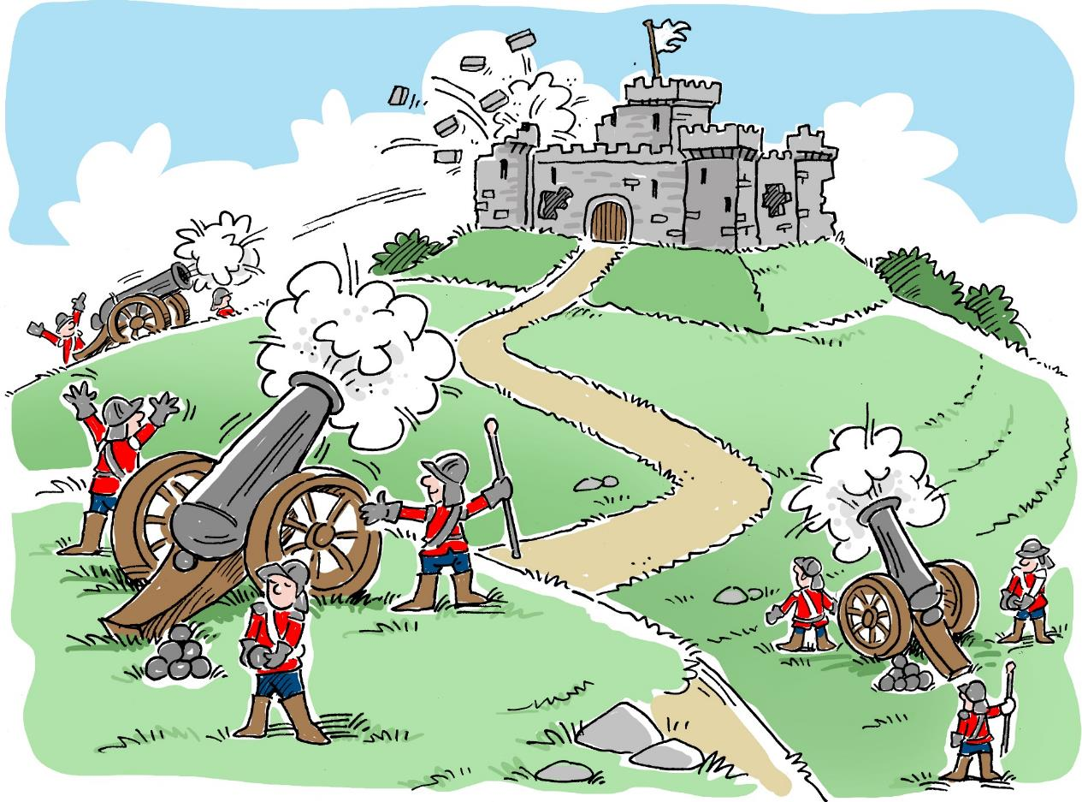
What is happening in this picture?

Slide 12
An army is surrounding this castle and cutting it off from the outside world.
The army is trying to force the people inside to surrender by starving them and bombarding them with cannon fire.
This is called a
SIEGE.

Slide 13
Sieges!
There were hundreds of sieges all over the country.
You can find out the nearest sieges to your school here.

Slide 14
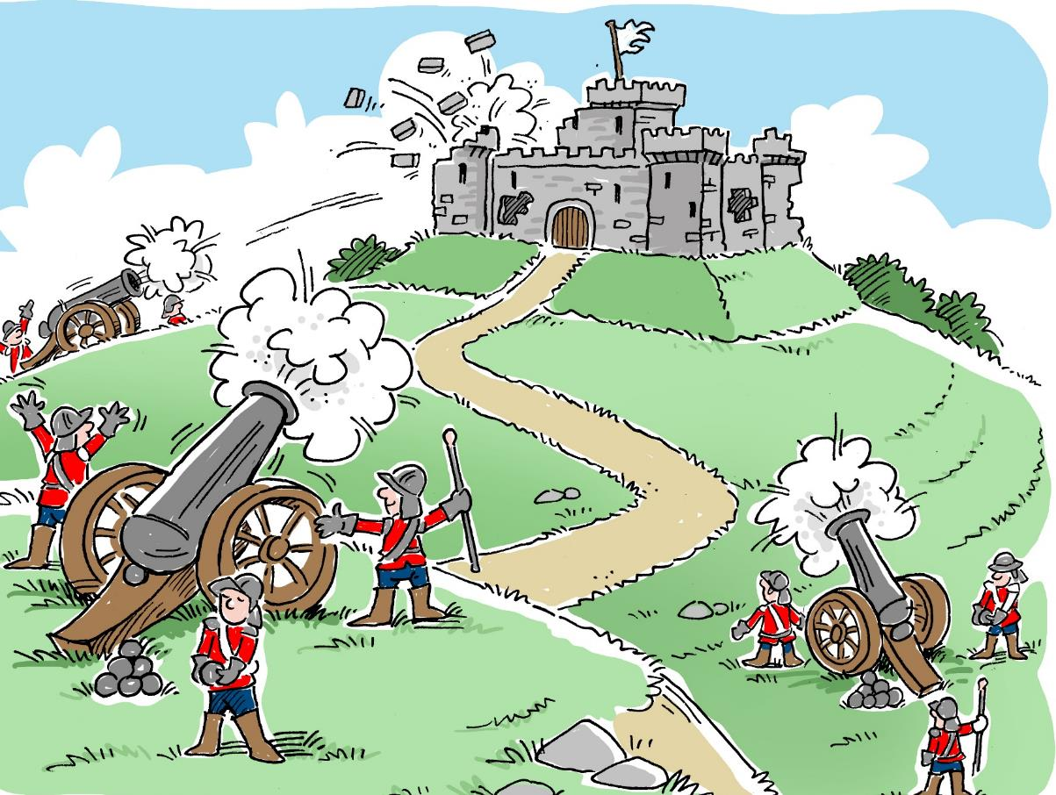
The use of cannon changed the way places all over the country defended themselves

Slide 15
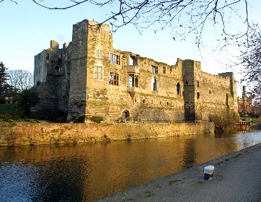
Defences
.
Medieval stone walls could be knocked down by cannonballs.
How do you think towns could defend themselves against cannon fire?
The marks of civil-war cannon fire can still be seen on the walls of Newark Castle in Nottinghamshire

Slide 16
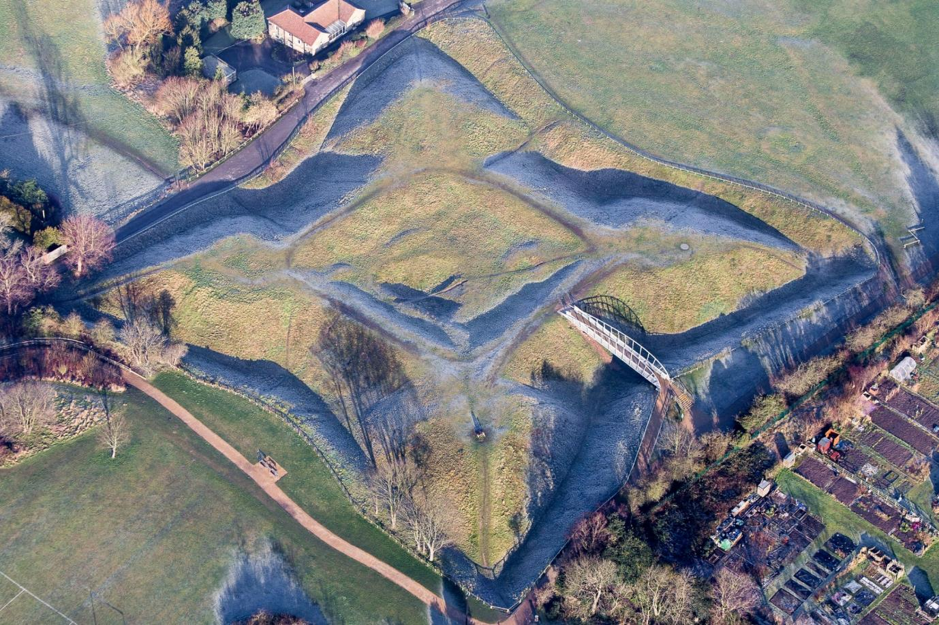
Earthwork Defences
Walls and forts like this one were made of tightly-packed earth which absorbed the shock of cannonballs instead of falling down.
.
The Queen’s Sconce
Newark, Nottinghamshire
Sconce is a Dutch word meaning fort

Slide 17
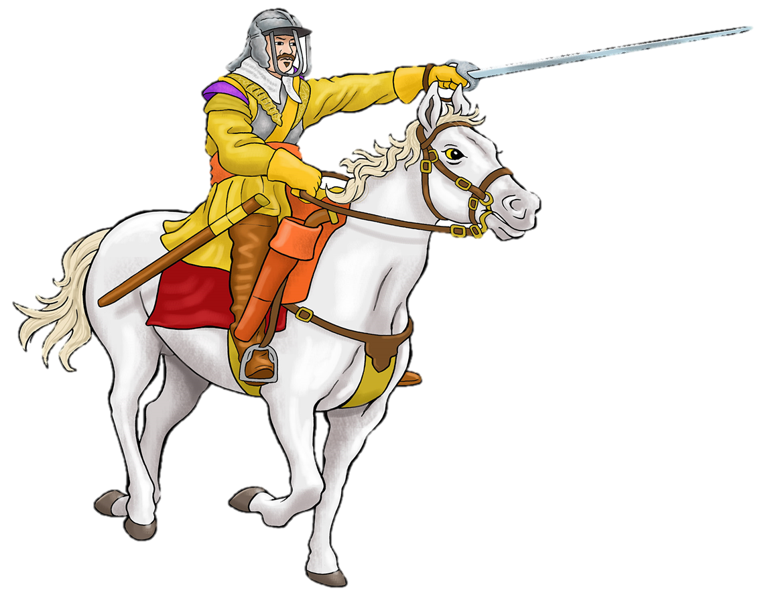
Besiege a Garrison
for the Roundheads!
It is 1645
You are Oliver Cromwell.
You are going to besiege an important royalist garrison in the south of England.

Slide 18
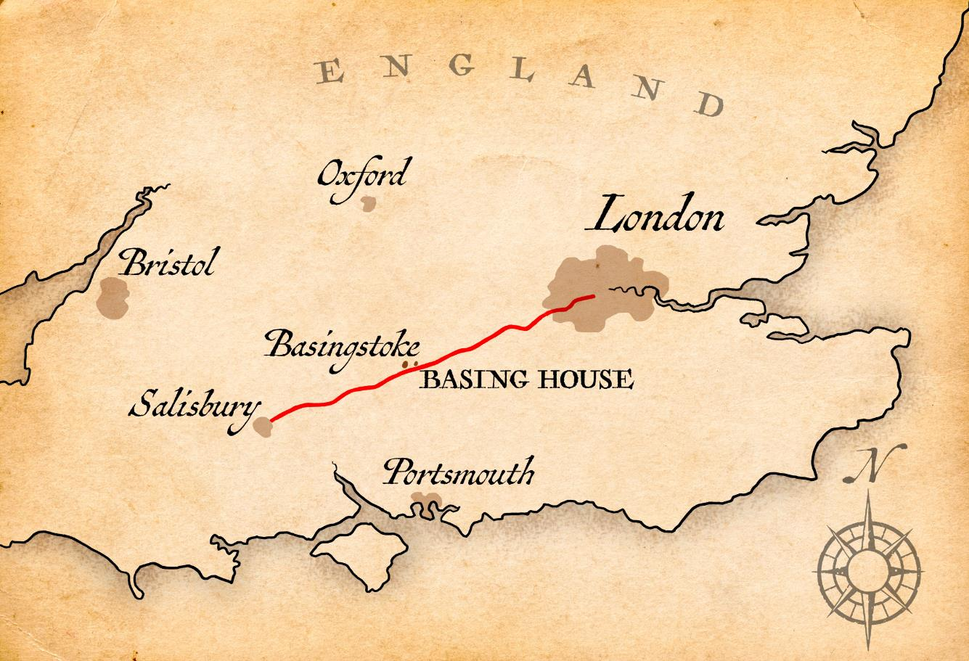
Basing House is owned by the Marquess of Winchester, a well known Royalist. He has garrisoned his large house for the King.
The Marquess is not only a Royalist. He is a Catholic! (You hate Catholics!)
His house is an important location because it is on the main road to the west through Salisbury
https://en.wikipedia.org/wiki/Siege_of_Basing_House

Slide 19
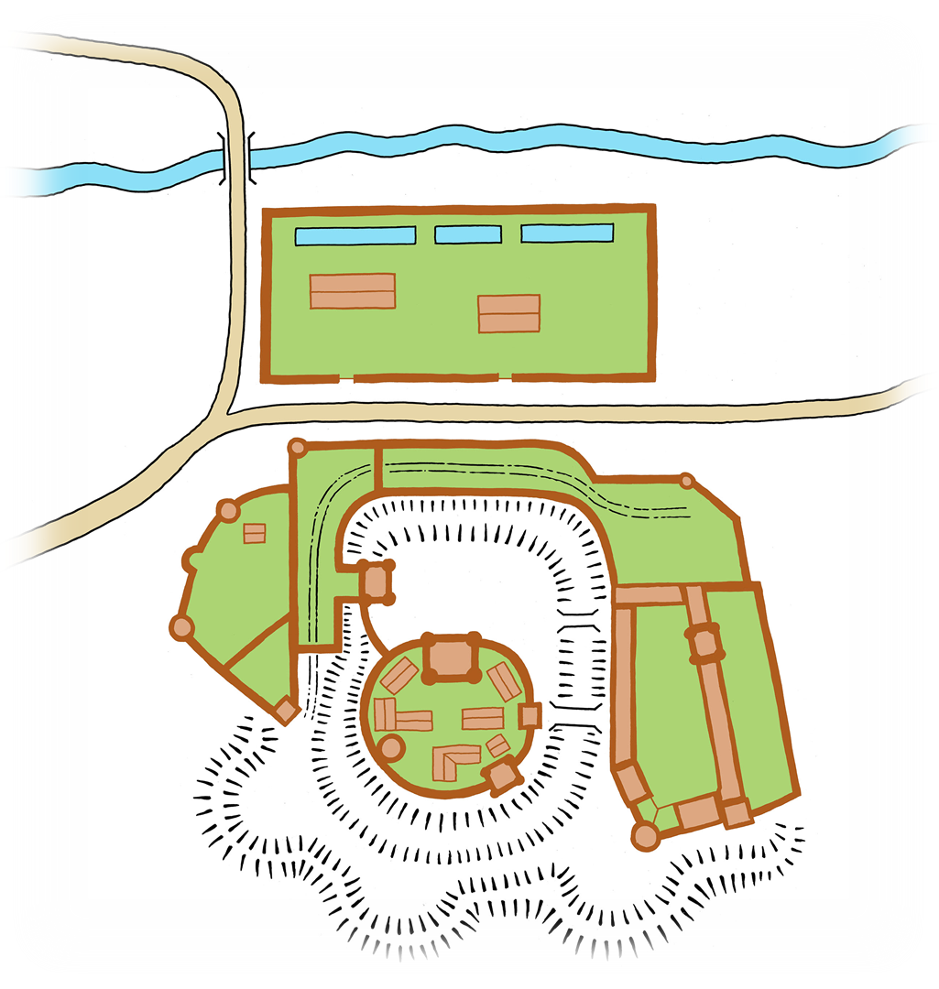
Here is a map of Basing House.
Can you find these things?
Fish ponds
Barns
The old medieval manor house
The new house
The barns and fishponds
Defensive earth walls
Garden
The Old House
The
New
House
Defensive earth walls

Slide 20
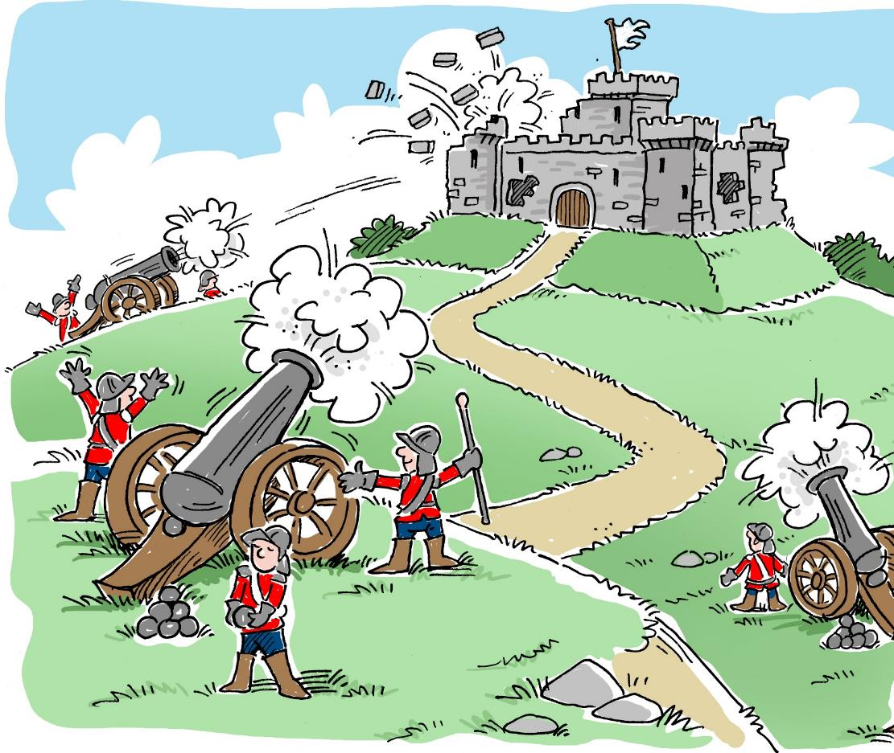
This is not going to be easy!
Sieges take a long time. They are expensive and dangerous and many of your soldiers will die.
Basing House has been besieged twice already and its soldiers and defences have held firm.
How can you succeed when others have failed?

Slide 21

Plan Your Attack
In order to take a garrison you must plan for 5 key Siege Challenges
.
Find a way in
Bombard the house
(to destroy its defences)
Fight the enemy soldiers
Surround the location
(so no one can get out)
Persuade the people inside
to surrender!
Which three of these challenges do you think might be most important?
How do you think you might achieve each of these?
Which one of these challenges will be most difficult ?

Slide 22

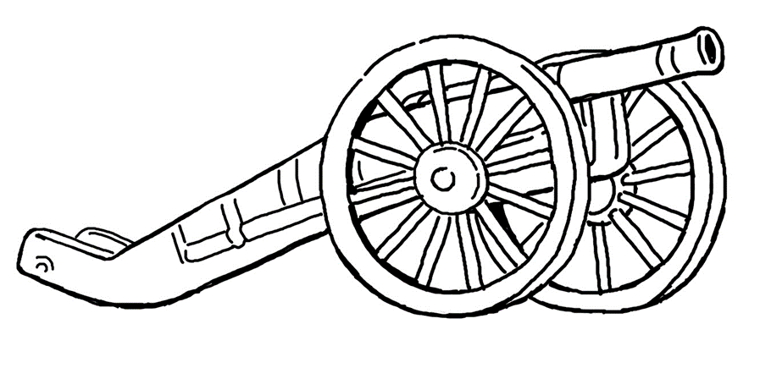
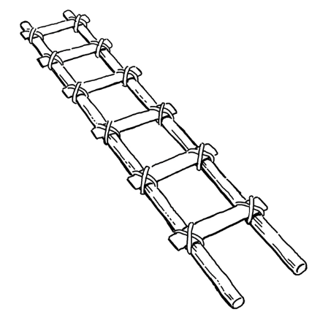

Plan Your Attack
Your quartermaster is in charge of supplies. He needs to order some special equipment.
Look at the ‘Plan of Attack’ worksheet.
Colour code the equipment to show which challenge it helps with.
The next slides suggest some answers…
.

Slide 23


Surround the garrison
Place your soldiers and cannon around the town
Block all entrances and exits.
Try to keep the garrison away from resources like rivers, ponds and fields if you can.
Make your own earth walls
.

Slide 24
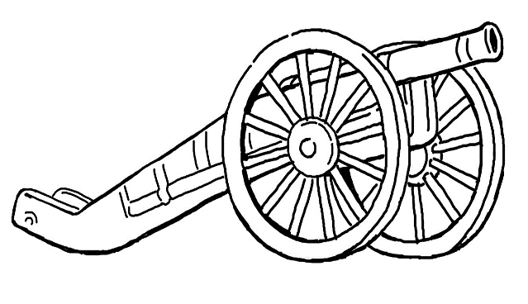


Bombard the garrison
Fire your cannon at the garrison to destroy its defences.
Grenadoes are terrifying siege weapons. Cannon called ‘mortars’ fire them high over earth walls. They burst into flames when they hit their target and burn buildings to the ground.

Slide 25

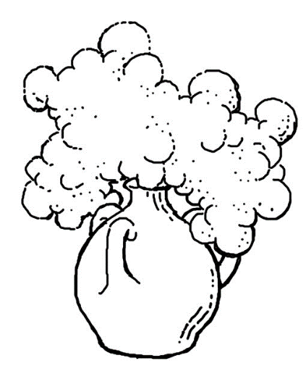
Bombard the garrison
In a previous siege at Basing house, sulphur bombs were also used to try and smoke people out.

Slide 26


Persuade the people inside to surrender
Set fire to houses with fire arrows or grenadoes to terrify the people inside
Try persuasion as well as fear. Send messages and newspapers into the town to convince the people inside that you will win. The people might call for a surrender!
You might also like to try and recruit a spy!

Slide 27


Find a way in
Carry bombs called ‘petards’ to doors and tie them on. Run away as fast as you can! This way you can blast a way in.
Use scaling ladders to climb walls and enter through windows

Slide 28
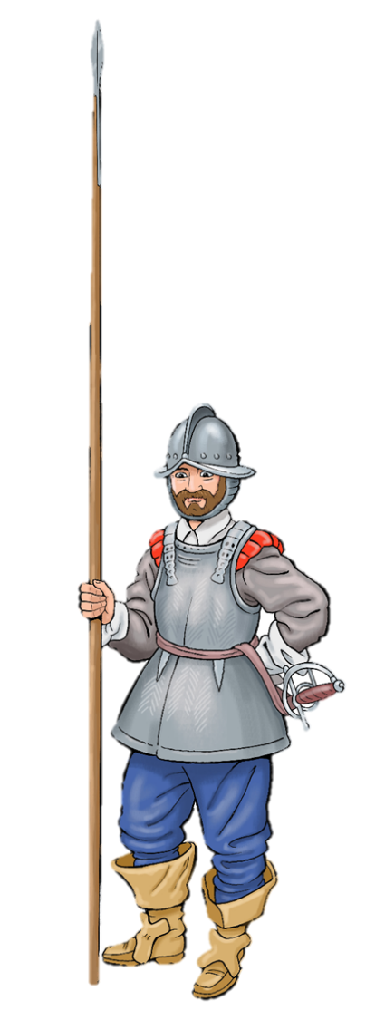
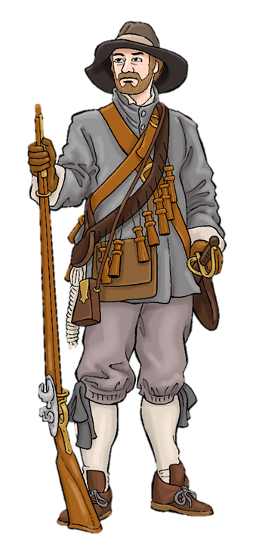

Fight the enemy
Use your soldiers and weapons to fight in hand to hand combat

Slide 29
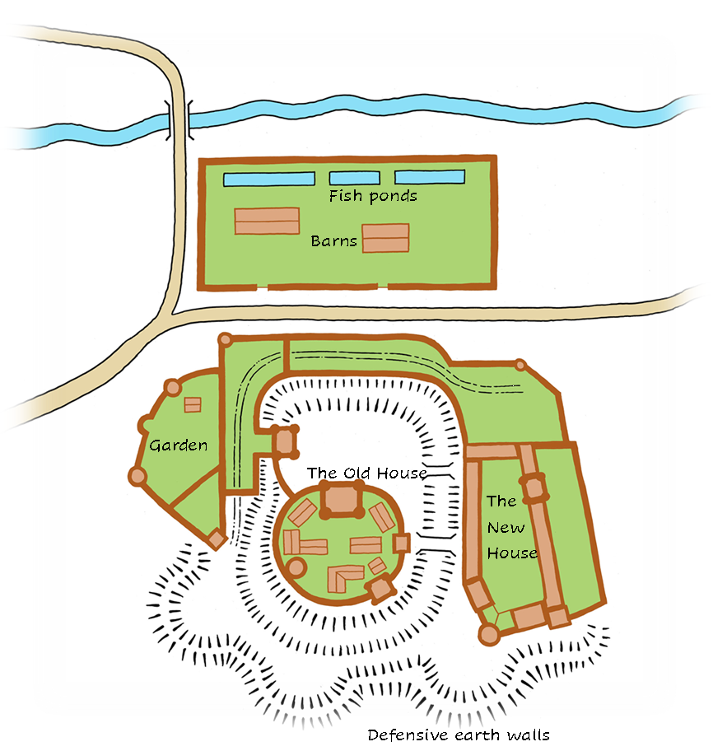
Now that you have chosen your supplies, its time to…
Plan Your attack!
Use counters/lego or other objects in your classroom to place your soldiers and weapons on your map. Build some earthworks too!
Now write your attack plan on the worksheet. What will you do and in what order? Share your ideas.

Slide 30
14th October 1645
You decide to storm Basing House!
This means you decide the siege has lasted long enough.
It is time to send in your army and take Basing House for Parliament!
The picture on the next slide shows what happens next. Can you work out what happens? Who do you think is going to win?

Slide 31
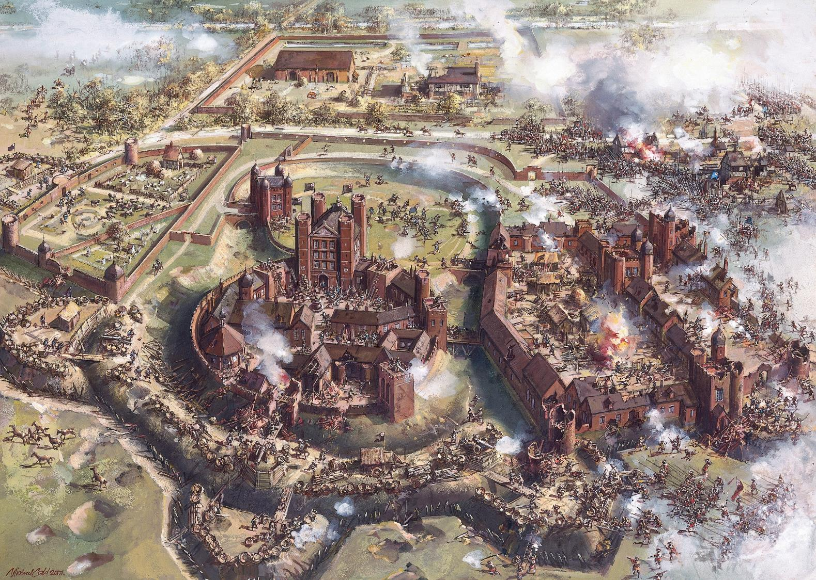
©Hampshire County Council collection. Provided by Hampshire Cultural Trust.

Slide 32
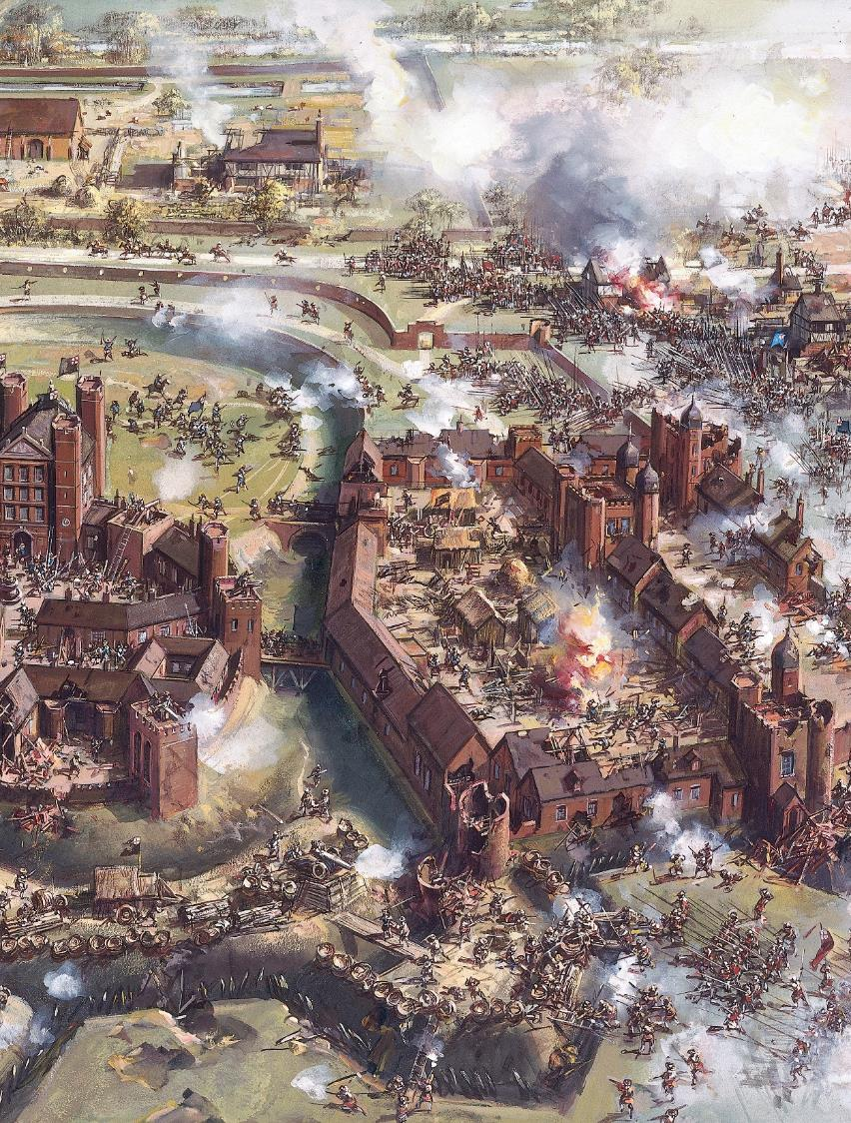
What happened on 14th October 1645?
Look at the picture again. Can you find these things?
Roundhead fire collapsed a tower
Roundhead cannon made a hole (or breach) in the walls for the army to storm through.
The Roundheads entered the house through the windows, using scaling ladders
There was hand to hand fighting in the house and grounds
A store of gunpowder blew up causing a fire that lasted for 24 hours
One of the leaders of the Cavaliers tried to surrender but was killed.
Almost every member of the garrison was taken prisoner or killed
One or two Royalists escaped over the wall.

Slide 33
Congratulations! You won!
You have taken Basing House
for Parliament!

